Slide 1

Chapter 18: Stacks And Queues
Copyright © 2009 Pearson Education, Inc. Publishing as Pearson Addison-Wesley

Slide 2
18.1
Introduction to the Stack ADT

Slide 3
Introduction to the Stack ADT
Stack: a LIFO (last in, first out) data structure
Examples:
plates in a cafeteria
return addresses for function calls
Implementation:
static: fixed size, implemented as array
dynamic: variable size, implemented as linked list

Slide 4
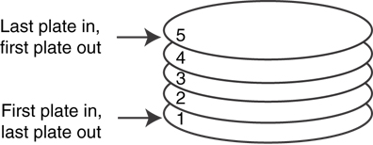
A LIFO Structure

Slide 5
Stack Operations and Functions
Operations:
push: add a value onto the top of the stack
pop: remove a value from the top of the stack
Functions:
isFull: true if the stack is currently full, i.e., has no more space to hold additional elements
isEmpty: true if the stack currently contains no elements

Slide 6
Stack Operations - Example
A stack that can hold char values:
K
E
G
K
E
E
push('E');
push('K');
push('G');

Slide 7
Stack Operations - Example
A stack that can hold char values:
E
K
E
pop();
(remove G)
pop();
(remove K)
pop();
(remove E)

Slide 8
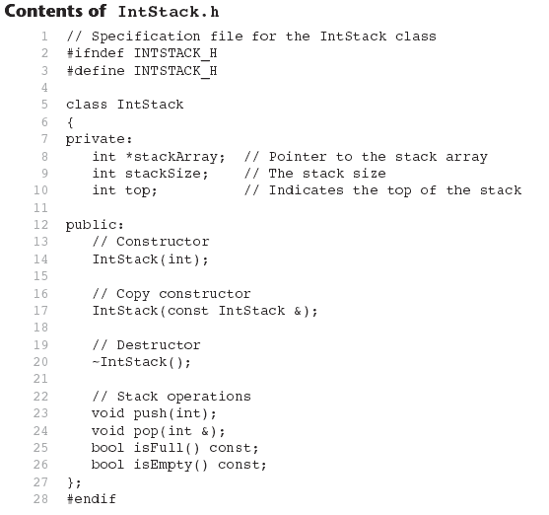
(See IntStack.cpp for the implementation.)

Slide 9
18.2
Dynamic Stacks

Slide 10
Dynamic Stacks
Grow and shrink as necessary
Can't ever be full as long as memory is available
Implemented as a linked list

Slide 11
Implementing a Stack
Programmers can program their own routines to implement stack functions
See DynIntStack class in the book for an example.
Can also use the implementation of stack available in the STL

Slide 12
18.3
The STL stack container

Slide 13
The STL stack container
Stack template can be implemented as a vector, a linked list, or a deque
Implements push, pop, and empty member functions
Implements other member functions:
size: number of elements on the stack
top: reference to element on top of the stack

Slide 14
Defining a stack
Defining a stack of chars, named cstack, implemented using a vector:
stack< char, vector<char> > cstack;
implemented using a list:
stack< char, list<char> > cstack;
implemented using a deque:
stack< char > cstack;
Spaces are required between consecutive >>, << symbols

Slide 15
18.4
Introduction to the Queue ADT

Slide 16
Introduction to the Queue ADT
Queue: a FIFO (first in, first out) data structure.
Examples:
people in line at the theatre box office
print jobs sent to a printer
Implementation:
static: fixed size, implemented as array
dynamic: variable size, implemented as linked list

Slide 17
Queue Locations and Operations
rear: position where elements are added
front: position from which elements are removed
enqueue: add an element to the rear of the queue
dequeue: remove an element from the front of a queue

Slide 18
Queue Operations - Example
A currently empty queue that can hold char values:
enqueue('E');
front
E
rear

Slide 19
Queue Operations - Example
enqueue('K');
enqueue('G');
front
E | K
rear
front
E | K | G
rear

Slide 20
Queue Operations - Example
dequeue(); // remove E
dequeue(); // remove K
front
K | G
rear
front
G
rear

Slide 21
dequeue Issue, Solutions
When removing an element from a queue, remaining elements must shift to front
Solutions:
Let front index move as elements are removed (works as long as rear index is not at end of array)
Use above solution, and also let rear index "wrap around" to front of array, treating array as circular instead of linear (more complex enqueue, dequeue code)

Slide 22
Contents of IntQueue.h 1 // Specification file for the IntQueue class 2 #ifndef INTQUEUE_H 3 #define INTQUEUE_H 4 5 class IntQueue 6 { 7 private: 8 int *queueArray; // Points to the queue array 9 int queueSize; // The queue size 10 int front; // Subscript of the queue front 11 int rear; // Subscript of the queue rear 12 int numItems; // Number of items in the queue

Slide 23

Contents of IntQueue.h
(Continued)
13 public: 14 // Constructor 15 IntQueue(int); 16 17 // Copy constructor 18 IntQueue(const IntQueue &); 19 20 // Destructor 21 ~IntQueue(); 22 23 // Queue operations 24 void enqueue(int); 25 void dequeue(int &); 26 bool isEmpty() const; 27 bool isFull() const; 28 void clear(); 29 }; 30 #endif
See IntQueue.cpp for the implementation

Slide 24
18.5
Dynamic Queues

Slide 25
Dynamic Queues
Like a stack, a queue can be implemented using a linked list
Allows dynamic sizing, avoids issue of shifting elements or wrapping indices
NULL
front
rear

Slide 26
Implementing a Queue
Programmers can program their own routines to implement queue operations
See the DynIntQue class in the book for an example of a dynamic queue
Can also use the implementation of queue and dequeue available in the STL

Slide 27
18.6
The STL deque and queue Containers

Slide 28
The STL deque and queue Containers
deque: a double-ended queue. Has member functions to enqueue (push_back) and dequeue (pop_front)
queue: container ADT that can be used to provide queue as a vector, list, or deque. Has member functions to enque (push) and dequeue (pop)

Slide 29
Defining a queue
Defining a queue of chars, named cQueue, implemented using a deque:
deque<char> cQueue;
implemented using a queue:
queue<char> cQueue;
implemented using a list:
queue< char, list<char> > cQueue;
Spaces are required between consecutive >>, << symbols

